Slide 1




Higher Education Capabilities
Hogan Lovells has an extensive, global higher education practice. Our education team addresses every aspect of law pertinent to higher education.
We represent the full range of institutions and other organizations in the education sector, including research universities, state universities, community colleges, private institutions, universities outside
the U.S., research institutes, leading sector associations, and foundations.
Areas of Focus
Education regulations
We advise on regulations specific to higher education institutions, including federal student financial aid, state authorization, accreditation, civil rights compliance, restrictions on incentive compensation and inducements, gainful employment disclosure and other requirements, distance education, campus safety, consumer protection and disclosure requirements, and privacy of student and other records.
Government investigations, litigation, and arbitration
Experienced Hogan Lovells litigators address nearly every type of dispute encountered by postsecondary education institutions. We represent institutions in audits and program reviews by the U.S. Department of Education, inquiries by the U.S. Department of Justice and other federal agencies, congressional investigations, adverse actions by accreditors, and investigations by state education and other agencies. We represent postsecondary education clients in courts across the country at the trial and appellate levels. Our geographic breadth provides clients access to litigators who practice in jurisdictions around the world and are experienced in international dispute resolution.
Civil rights compliance
We have broad and deep experience with civil rights laws relating to students and employees. At Hogan Lovells, we counsel education-sector clients on compliance, and we represent them
in government agency investigations and in state and federal court.
We advise on race, sex, disability, age, and religious discrimination; initiatives to increase diversity among students, faculty, and staff; racial, sexual, and disability harassment; sexual violence; race- and gender-based programs; and First Amendment issues. At the K-12 level, we have extensive experience with equitable access to programs and resources, programs for English Language Learners, Section 504 and IDEA requirements, and integration and desegregation.
Governance
Higher education institutions comply with ever-changing regulatory requirements and adapt to evolving norms of governance. At Hogan Lovells, we have extensive experience in advising universities, colleges, academic medical centers, research organizations, and other education groups on all aspects of institutional governance.
Tier 1 in Education
Legal 500 United States 2023
Advising more than 20 of the top 25 U.S. universities
U.S. News and World Report
Chambers Asia Pacific

Slide 2

Sponsored research
Academic research sponsors, both governmental and private, impose strict requirements on institutions they fund. Funding recipients are expected to account for and report costs accurately, monitor sub-recipients carefully, and responsibly manage property purchased with sponsor funds. Recipients must also ensure the integrity and safety of research through policies on conflicts of interest, research involving human subjects and laboratory animals, biosafety, and research misconduct, to name just a few. These sponsored research requirements are expanding, and government enforcement of them is intensifying, at a time when compliance resources have become severely constrained at most institutions. All responsible research institutions, however, recognize that failure to comply with these requirements may not only compromise the scientific and ethical integrity of their research, but also expose them to the risk of legal liability and loss of funding.
Our broad experience in the area of sponsored research allows us to advise clients efficiently, practically, and sure-handedly.
Intellectual property
Our education and intellectual property lawyers work together to advise clients about identification, protection, and, where appropriate, commercialization of patents, copyrights, trademarks, and trade secrets. We have assisted with such issues as contracts for development, acquisition, and distribution of content for distance learning programs; contracts for technology to deliver distance learning content to students; and protecting valuable trademark rights in connection with client sponsorship of new domestic and non-domestic learning initiatives.
International programs
A branch campus in China. A field office in South Africa. A study abroad site in Mexico. An online course in Saudi Arabia. Our worldwide team guides institutions through these and other transnational initiatives. We daily advise on faculty and staff postings abroad, international recruitment, foreign degree programs, and cross-border research. We tackle the nuts and bolts of international ventures, including corporate structure, licensure and accreditation, research compliance, and export controls. Our experience at the intersection of education and globalization helps you anticipate and deal with risks before they become problems.
Education-focused transactions
We can handle every aspect of education sector transactions, including transactions involving distance education, international programs, acquisition and disposition of investments, outsourcing and information technology contracts, and changes in ownership and control.
“We could not ask for a better legal partner than Hogan Lovells. Everything about the firm and our experience with them has been top notch. They have a truly global reach that allows them to be a one-stop shop for us. They are always readily available to answer any queries we may have.”
Client Testimonial
Legal 500 United States 2023

Slide 3
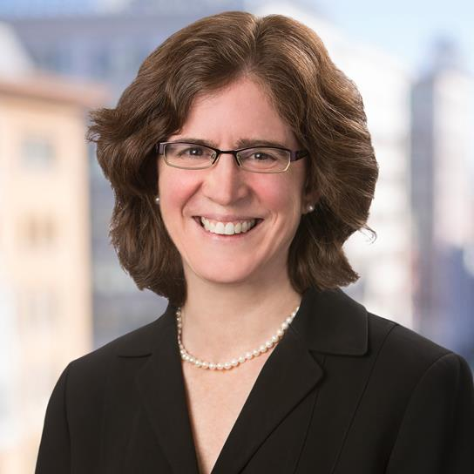
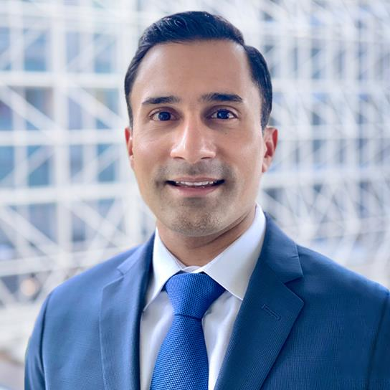
Privacy
We have deep experience in privacy issues in higher education, such as privacy of education records, as well as health, financial, and other personal information. We have guided clients through the challenges that expanded federal regulation and technological advances present.
Labor and employment
We work with our university clients as advisors, negotiators, and litigators. Our decades of experience with colleges and universities and all phases of the employment relationship for faculty and staff permit us to provide sophisticated advice on sensitive individual problems and effective personnel systems. We guide clients through the maze of issues involving equal employment opportunity, wages and hours law, leave and benefits, termination and discipline, labor unions, protection of institutional assets, executive contracts, and personnel policies. While focused on claim prevention, we aggressively defend claims when filed. We advise universities concerning the international workplace, including which employment-related laws apply and managing international mobility.
Key Contacts
Stephanie Gold
Partner
Washington, D.C.
stephanie.gold@hoganlovells.com
William Ferreira
Partner
Washington, D.C.
william.ferreira@hoganlovells.com
Why us
A clear choice
A bold and distinctive law firm creating valuable solutions for our clients around the world, particularly at the intersection of business and government.
Global Diversity & Inclusion goals
Market recognition
We continue to work diligently to achieve 30% women in the partnership globally.
Ranked amongst the top 10 strongest legal brands globally.
- Thompson Reuters Global Elite Law Firm Brand Index 2022
Top numbers
45+
100+
22+
offices globally
years of history
countries
2600+
70+
450+
lawyers
languages
lawyers ranked by Chambers & Partners
* Global racial/ethnic minority and LGBTQ+ partner goals encompass the U.S. and UK only owing to legal restrictions.

